Slide 1


TP558 - Tópicos avançados em Machine Learning
Graph Neural Networks
Hanieh Memarian
hanieh.memarian@dtel.inatel.br

Slide 2
Outline
Introduction
Definition & Develo- pment of GNN
Challenges
Article
Future work & Conclusion
5
Background
Basic problem
Where GNNS are used
What is graph
What is GNN
Why is GNN Useful
Development Idea of GNN
Definition of GNN
Over-smoothing with depth
The scalability
Heterogeneity, dynamicity, robustness
Theory rarely guides design
Algorithm
Simulation Results
Conclusion
Future Directions
4
3
2
1

Slide 3
Introduction

Slide 4
Introduction
Most real-world data is not a grid
Euclidean data (images, text)
Non-Euclidean data (graphs)
Fixed neighborhoods, ordered pixels/tokens — CNNs and RNNs exploit shift-invariance and local connectivity.
Variable-size, unordered neighborhoods: molecules, social networks, citation graphs, sensor and wireless networks.
Zhou et al., “Graph Neural Networks: A Review of Methods and Applications,” AI Open, 2020; Wu et al., “A Comprehensive Survey on Graph Neural Networks,” 2019/2021.
Graph Neural Networks
4/40

Slide 5
Introduction
Why standard neural networks fall short on graphs
No fixed node ordering
A graph has no canonical order for its nodes — CNN filters and RNN sequences assume one.
1
Variable neighborhood size
Each node can have a different number of neighbors; convolution kernels expect a fixed receptive field.
2
Broken independence assumption
Traditional ML assumes i.i.d. samples; graph nodes are explicitly linked by edges of many types.
3
Structure carries information
Flattening a graph into a feature vector during preprocessing discards topology that is often the signal itself.
4
Zhou et al., “Graph Neural Networks: A Review of Methods and Applications,” AI Open, 2020; Wu et al., “A Comprehensive Survey on Graph Neural Networks,” 2019/2021.
Graph Neural Networks
5/40

Slide 6
Introduction
GNNs already power a wide range of domains
Chemistry & Biology
Physics
Knowledge Graphs
Computer Vision
Molecular fingerprints, drug discovery, protein interface prediction
Particle & robotic systems, interaction/relational reasoning
Entity embedding, link prediction, KG alignment
Scene graphs, point clouds, few-shot & zero-shot recognition
Text & NLP
Recommendation
Traffic Networks
Wireless Networks
Text classification, relation & event extraction, NMT
User–item graphs, social recommendation (PinSAGE, GC-MC)
Spatial-temporal forecasting of flow, speed, demand
Resource management, beamforming, network modeling — today’s case study
Zhou et al., “Graph Neural Networks: A Review of Methods and Applications,” AI Open, 2020; Wu et al., “A Comprehensive Survey on Graph Neural Networks,” 2019/2021.
Graph Neural Networks
6/40

Slide 7
Definition and Development
of GNN

Slide 8
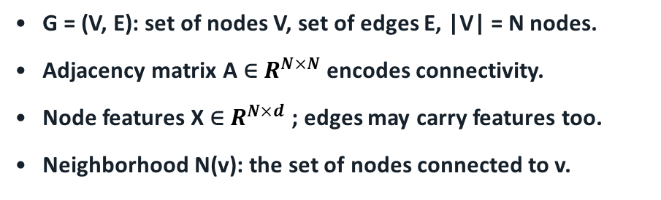
Definition and Development of GNN
Formal notation: graphs, nodes, and neighborhoods
Graph types
Node ●
Edge —
Directed vs. undirected
Homogeneous vs. heterogeneous (typed nodes/edges)
Static vs. dynamic (topology/features vary in time)
Positional vs. non-positional (ordered neighbor slots or not)
G = (V, E): set of nodes V, set of edges E, |V| = N nodes.
Adjacency matrix A ∈ $R^{N×N}$ encodes connectivity.
Node features X ∈ $R^{N×d}$ ; edges may carry features too.
Neighborhood N(v): the set of nodes connected to v.
Zhou et al., “Graph Neural Networks: A Review of Methods and Applications,” AI Open, 2020; Wu et al., “A Comprehensive Survey on Graph Neural Networks,” 2019/2021.
Graph Neural Networks
8/40

Slide 9
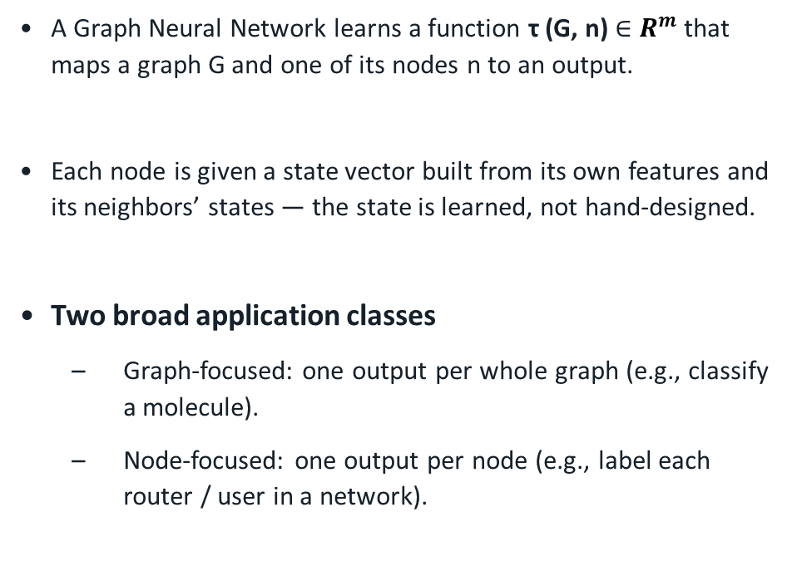
Definition and Development of GNN
A GNN maps a graph (and a node) to a vector
A Graph Neural Network learns a function τ (G, n) ∈ $R^{m}$ that maps a graph G and one of its nodes n to an output.
Each node is given a state vector built from its own features and its neighbors’ states — the state is learned, not hand-designed.
Two broad application classes
  Graph-focused: one output per whole graph (e.g., classify a molecule).
  Node-focused: one output per node (e.g., label each router / user in a network).
Graph-focused
single output
Node-focused
output per node
Zhou et al., “Graph Neural Networks: A Review of Methods and Applications,” AI Open, 2020; Wu et al., “A Comprehensive Survey on Graph Neural Networks,” 2019/2021.
Graph Neural Networks
9/40

Slide 10
Definition and Development of GNN
Relational inductive bias & permutation invariance
GNNs are equivariant to node/edge permutation: relabel the nodes and the model produces the same (reordered) answer.
This “strong relational inductive bias” lets a GNN find symmetries and equivalent sub-structures between graphs seen in training and new graphs.
Consequence: a GNN trained on one graph size/topology generalizes to unseen sizes and structures — fully-connected NNs cannot.
Same graph, different order → same model
labels: 1..6
labels: shuffled
→ identical output embedding, up to permutation
Zhou et al., “Graph Neural Networks: A Review of Methods and Applications,” AI Open, 2020; Wu et al., “A Comprehensive Survey on Graph Neural Networks,” 2019/2021.
Graph Neural Networks
10/40

Slide 11
Definition and Development of GNN
Development idea: message passing
1
Initialize
2
Message
3
Aggregate
4
Update
Each node gets a hidden state from its own input features (zero-padded if needed).
Every edge computes a message from the states of its two endpoints (+ edge features).
Each node combines incoming messages (sum / mean / max / attention) into one summary vector.
The node combines the aggregated message with its previous state to get a new state.
Repeated for T layers/iterations → information from T-hop neighborhoods reaches every node; run again on a completely different graph without retraining the same building blocks.
Zhou et al., “Graph Neural Networks: A Review of Methods and Applications,” AI Open, 2020; Wu et al., “A Comprehensive Survey on Graph Neural Networks,” 2019.
Graph Neural Networks
11/40

Slide 12
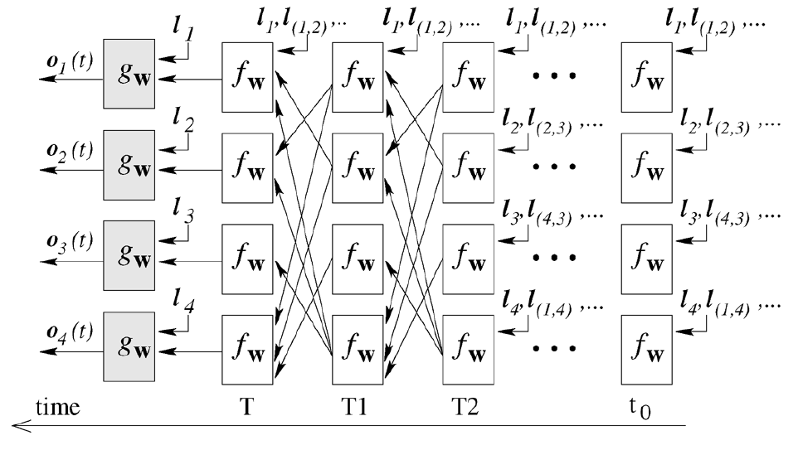
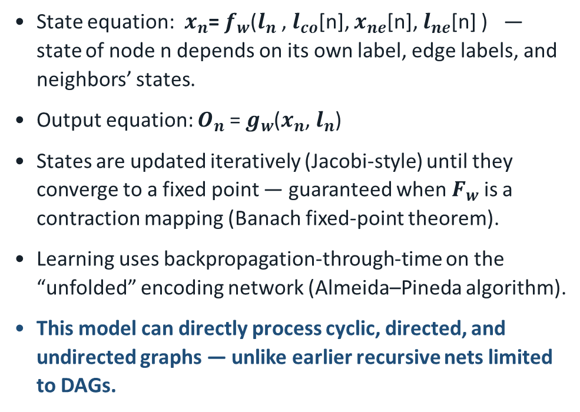
Definition and Development of GNN
Scarselli et al. (2009): recurrent diffusion to a fixed point
State equation: $x_{n}$= $f_{w}$($l_{n}$ , $l_{co}$[n], $x_{ne}$[n], $l_{ne}$[n] ) — state of node n depends on its own label, edge labels, and neighbors’ states.
Output equation: $O_{n}$= $g_{w}$($x_{n}$, $l_{n}$)
States are updated iteratively (Jacobi-style) until they converge to a fixed point — guaranteed when $F_{w}$is a contraction mapping (Banach fixed-point theorem).
Learning uses backpropagation-through-time on the “unfolded” encoding network (Almeida–Pineda algorithm).
This model can directly process cyclic, directed, and undirected graphs — unlike earlier recursive nets limited to DAGs.
Encoding network (unfolded in time)
t0
t1
t2
T
Each column = one time step, sharing the same weights f_w, g_w — a recurrent network unfolded over the graph.
Franco Scarselli et al., “The Graph Neural Network Model,” IEEE TRANSACTIONS ON NEURAL NETWORKS, VOL.20, NO. 1, JANUARY 2009
Graph Neural Networks
12/40

Slide 13
Definition and Development of GNN
Four families of modern GNNs
RecGNN
ConvGNN
GAE
STGNN
Recurrent GNNs
Convolutional GNNs
Graph Autoencoders
Spatial-Temporal GNNs
Propagate neighbor information until a stable equilibrium (original GNN, GraphESN, GGNN).
Stack fixed layers, each with its own weights (spectral: ChebNet, GCN; spatial: GraphSAGE, GAT).
Encode nodes/graphs to a latent space and reconstruct structure — unsupervised embeddings and graph generation.
Combine graph convolutions with RNNs/1D-CNNs to model graphs that evolve over time (e.g., traffic).
Zonghan Wu et al., “A Comprehensive Survey on Graph Neural Networks ,” arXiv:1901.00596v4, 2019
Graph Neural Networks
13/40

Slide 14
Definition and Development of GNN
Two ways to define “convolution” on a graph
Spectral approaches
Spatial approaches
Define filters in the graph-Fourier (Laplacian eigenvector) domain.
ChebNet, GCN approximate the filter with polynomials to avoid full eigendecomposition.
Limitation: filters are tied to a fixed graph structure — harder to transfer across graphs.
Aggregate neighbor features directly in the graph domain (message passing).
GraphSAGE, GAT, MPNN — efficient, flexible, and generalize to unseen graphs.
Dominant choice for large-scale and inductive settings — including wireless networks.
Zhou et al., “Graph Neural Networks: A Review of Methods and Applications,” AI Open, 2020.
Graph Neural Networks
14/40

Slide 15
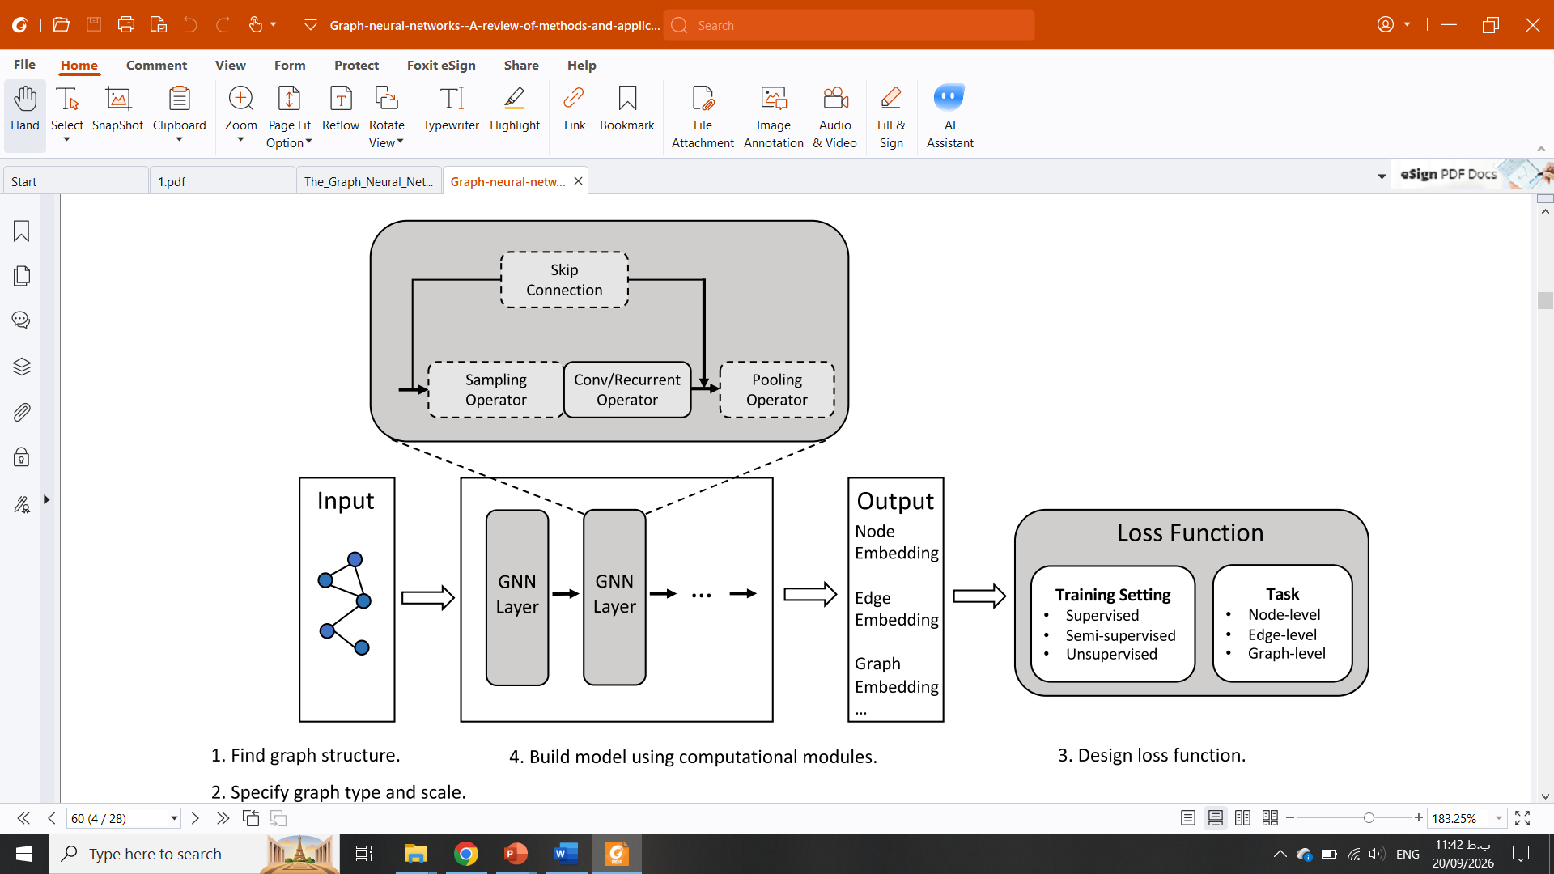
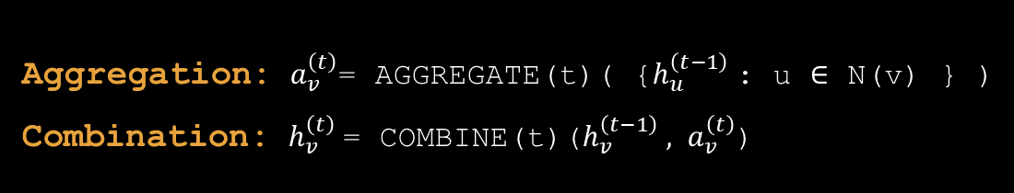
Definition and Development of GNN
One GNN layer, written out
Aggregation: $a_{v}^{\left(t\right)}$= AGGREGATE(t)( {$h_{u}^{\left(t−1\right)}$: u ∈ N(v) } )
Combination: $h_{v}^{\left(t\right)}$= COMBINE(t)($h_{v}^{\left(t−1\right)} , a_{v}^{\left(t\right)}$)
AGGREGATE is permutation-invariant (sum, mean, max, or learned attention) so node order never matters.
COMBINE and AGGREGATE are typically small MLPs whose weights are shared across every node in the graph.
A final READOUT pools all node states into a graph-level vector, if the task is graph-focused.
This general layer is what will later be specialized into GNN architectures for wireless resource-management problems.
Zhou et al., “Graph Neural Networks: A Review of Methods and Applications,” AI Open, 2020; Wu et al., “A Comprehensive Survey on Graph Neural Networks,” 2019.
Graph Neural Networks
15/40

Slide 16
Challenges

Slide 17
Challenges
Limitation 1: over-smoothing with depth
Layer 1
Layer 2
Layer 4
Layer 8 (over-smoothed)
Each extra layer averages a node’s state with more of the graph — after enough layers, all node representations converge to the same value.
This caps how deep (and therefore how far-reaching) a GNN can practically be, limiting long-range dependency modeling.
Mitigations: skip/residual connections (JKNet, ResGCN, DenseGCN), normalization, or careful choice of pooling.
Graph Neural Networks
17/40

Slide 18
Challenges
Limitation 2: the scalability / completeness trade-off
Full-batch training over a graph’s whole adjacency matrix (O(N²) space) is infeasible for graphs with millions of nodes.
Sampling is the fix — but it always discards part of the graph:
  Node sampling (GraphSAGE): fixed number of neighbors per node.
  Layer sampling (FastGCN): fixed set of nodes per layer.
  Subgraph sampling (Cluster-GCN, GraphSAINT): train on sampled sub-graphs.
Every scheme trades some structural completeness for tractable memory and compute.
Full graph
sample
Sampled sub-graph
Graph Neural Networks
18/40

Slide 19
Challenges
Limitations 3 & 4 & 5: heterogeneity, dynamicity, robustness
Heterogeneous graphs
Dynamic graphs
Robustness & interpretability
Most GNNs assume one node/edge type. Mixed types (users, APs, antennas) need custom meta-path or relation-specific weights.
Topology and features can change over time; standard GNNs assume a static snapshot unless paired with RNNs/temporal attention.
GNNs are vulnerable to adversarial structure/feature perturbations and remain largely black-box models.
Graph Neural Networks
19/40

Slide 20
Challenges
The deepest limitation: theory rarely guides design
Empirically, GNNs beat MLPs/CNNs on graph tasks — but until recently, the only “proof” offered was the permutation-invariance argument.
That argument explains why GNNs are not worse, but not how much better they are, nor which GNN design is best for a given problem.
Without a quantitative theory, choosing an architecture is trial-and-error — costly for domains like wireless networks with strict latency and hardware budgets.
Preview of the theory to come
O(n)
× lower generalization error than MLPs
O(n²)
× fewer training samples needed, for an n-node graph
Graph Neural Networks
20/40

Slide 21
Article
Graph Neural Networks for Wireless Communications: From Theory to Practice

Slide 22
Article
Off-the-shelf MLPs/CNNs break down at scale
18%
Why this matters for 5G/6G
Densely deployed access points and hundreds of clients are the norm, not the exception.
Client counts and SNR change dynamically — a model tuned for one snapshot must still work on the next.
⇒ Poor scalability + poor generalization make plain MLP/CNN architectures ineffective for practical deployment.
Performance gap of a CNN-based beamforming model going from a 2-user to a 10-user D2D network.
>50%
Degradation of an MLP-augmented branch-and-bound access-point selector when user count/SNR shift slightly from training.
Yifei Shen et al., "Graph Neural Networks for Wireless Communications: From Theory to Practice," in IEEE Transactions on Wireless Communications, May 2023.
Graph Neural Networks
22/40

Slide 23
Article
Four contributions of the paper
Graph modeling framework
A general recipe for casting wireless problems (power control, hybrid precoding, cell-free MIMO) as graph optimization problems.
1
GNNs ≡ distributed message passing
GNNs are shown to be the most powerful class of Distributed Message Passing (DMP) algorithms — they can represent WMMSE, Riemannian gradient, belief propagation, and more.
2
First generalization analysis
Via PAC-learning + algorithmic alignment: GNNs need O(n²) fewer samples and reach O(n) lower generalization error than MLPs, for an n-node graph.
3
Theory-guided design methodology
Four concrete guidelines to improve any base GNN architecture, validated across three wireless problems.
4
Yifei Shen et al., "Graph Neural Networks for Wireless Communications: From Theory to Practice," in IEEE Transactions on Wireless Communications, May 2023.
Graph Neural Networks
23/40

Slide 24
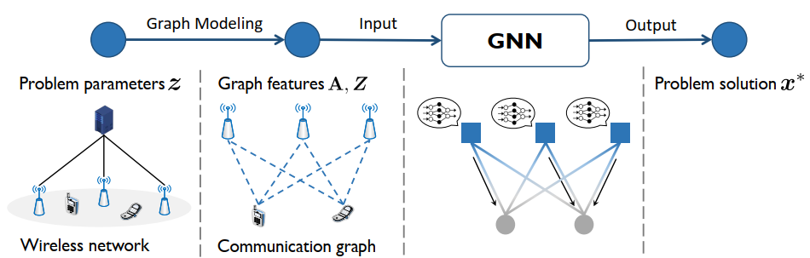
Article
From wireless network to GNN solution
Two parallel threads :
algorithm design — model as a graph, build a matching GNN, refine with theory-guided rules;
theoretical analysis — prove GNNs can learn the optimal algorithm, then bound their sample complexity vs. MLPs.
Yifei Shen et al., "Graph Neural Networks for Wireless Communications: From Theory to Practice," in IEEE Transactions on Wireless Communications, May 2023.
Graph Neural Networks
24/40

Slide 25
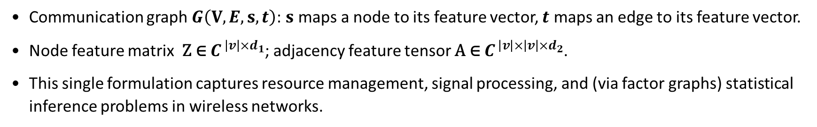
Article
Wireless problems as graph optimization
$\min_{x} f\left(X,Z, A\right)$ subject to Q$\left(X,Z, A\right)$≤ 0
X: optimization variable per node (e.g., transmit power) Z: node feature matrix A: adjacency feature tensor (edges)
Communication graph $G\left(V,E,s,t\right)$: $s$ maps a node to its feature vector, $t$ maps an edge to its feature vector.
Node feature matrix ${\text{Z} \text{∈} C}^{ \left|v\right|×d_{1}}$; adjacency feature tensor ${\text{A} \text{∈} C}^{ {\left|v\right|×\left|v\right|×d}_{2}}$.
This single formulation captures resource management, signal processing, and (via factor graphs) statistical inference problems in wireless networks.
Yifei Shen et al., "Graph Neural Networks for Wireless Communications: From Theory to Practice," in IEEE Transactions on Wireless Communications, May 2023.
Graph Neural Networks
25/40

Slide 26
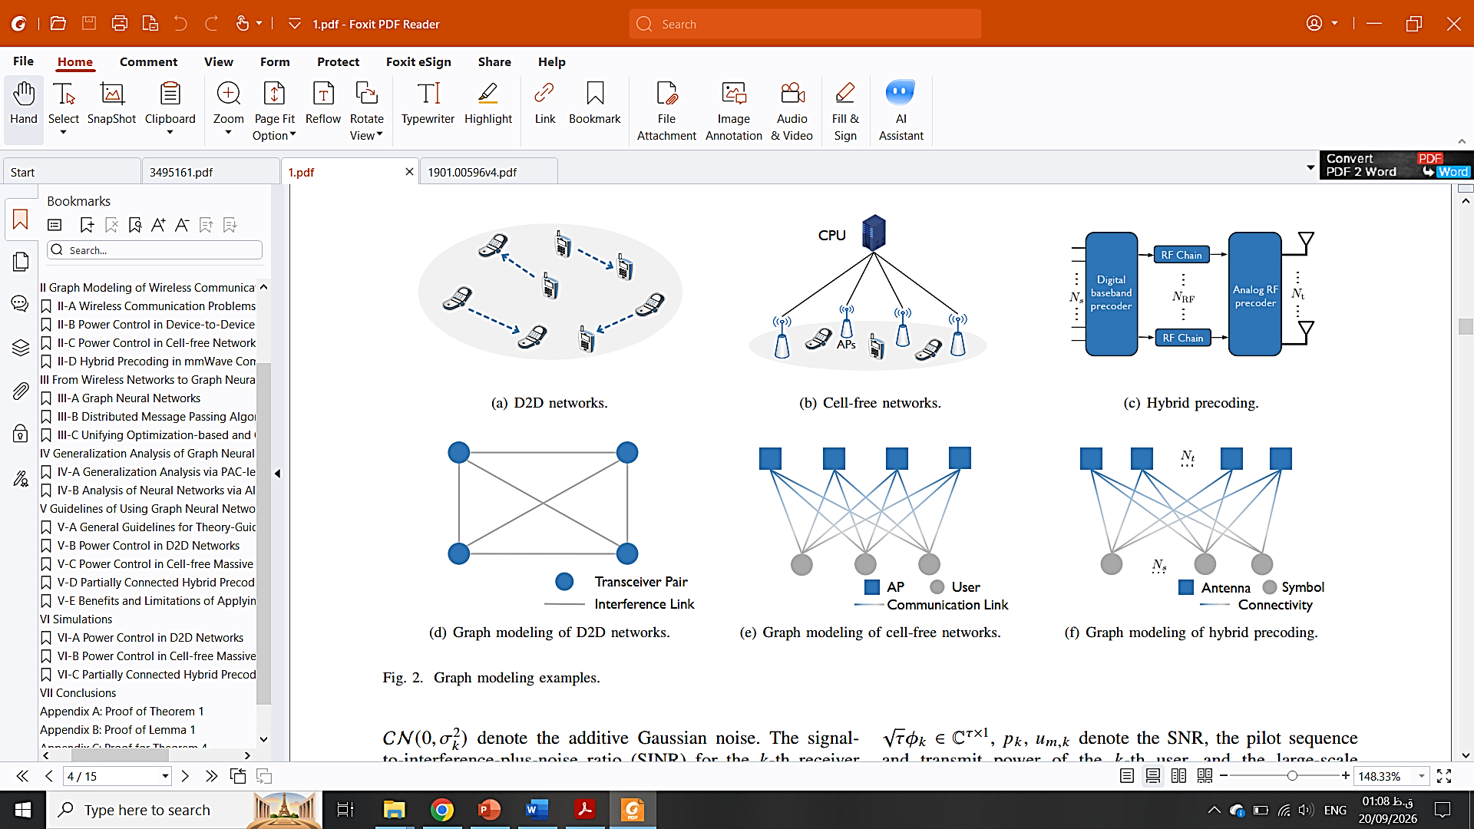
Article
Table I -Three running examples used throughout the paper
Problem Type
System Model
Graph Type
Node / Node Features
Edge / Edge Features
Resource management
D2D networks
Weighted graph
Transceiver pair / Direct-link channels
Interference links / Interference channels
Resource management
Cell-free networks
Bipartite graph
UEs & APs / No feature
Direct links / Large-scale coefficients
Signal processing
Hybrid precoding
Bipartite graph
Symbols & antennas / No feature
Connectivity / Digital beamforming matrix
Yifei Shen et al., "Graph Neural Networks for Wireless Communications: From Theory to Practice," in IEEE Transactions on Wireless Communications, May 2023.
Graph Neural Networks
26/40

Slide 27
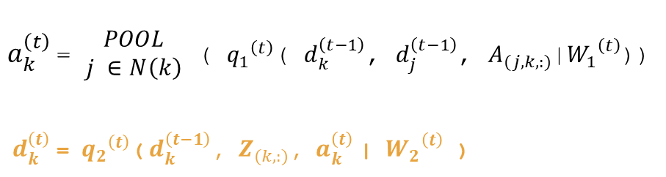
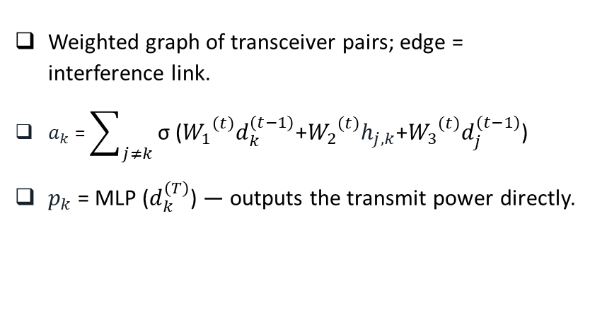
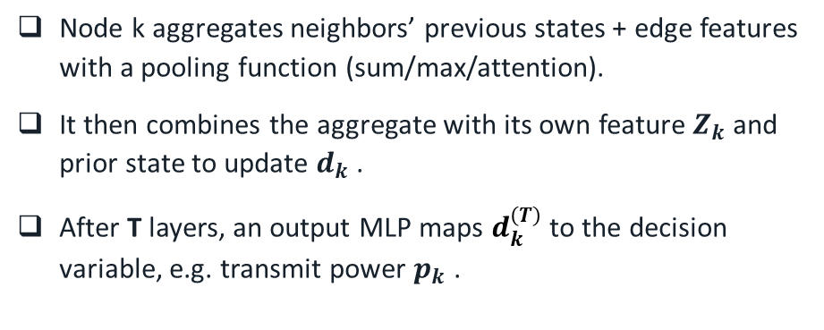
Article
Aggregation and combination on a wireless graph
Example: ECGNN for D2D power control
$a_{k}^{\left(t\right)}$= $\begin{matrix}POOL \\ j ∈N\left(k\right)\end{matrix}$ ( ${q_{1}}^{\left(t\right)}$( $d_{k}^{\left(t−1\right)}$, $d_{j}^{\left(t−1\right)}$, $A_{(j,k,:)}$|${W_{1}}^{\left(t\right)}$))
$d_{k}^{\left(t\right)}$= ${q_{2}}^{\left(t\right)}$(${ d}_{k}^{\left(t−1\right)}$, $Z_{(k,:)}$, $a_{k}^{\left(t\right)}$| ${W_{2}}^{\left(t\right)}$ )
Node k aggregates neighbors’ previous states + edge features with a pooling function (sum/max/attention).
It then combines the aggregate with its own feature $Z_{k}$ and prior state to update $d_{k}$ .
After T layers, an output MLP maps $d_{k}^{\left(T\right)}$ to the decision variable, e.g. transmit power $p_{k}$ .
Weighted graph of transceiver pairs; edge = interference link.
$a_{k}$ = $\sum_{j≠k}{\text{σ} \text{(}{W_{1}}^{\left(t\right)}d_{k}^{\left(t−1\right)}\text{+}{W_{2}}^{\left(t\right)}h_{j,k}\text{+}{W_{3}}^{\left(t\right)}d_{j}^{\left(t−1\right)}\text{)} }$
$p_{k}$ = MLP ($d_{k}^{\left(T\right)}$) — outputs the transmit power directly.
Yifei Shen et al., "Graph Neural Networks for Wireless Communications: From Theory to Practice," in IEEE Transactions on Wireless Communications, May 2023.
Graph Neural Networks
27/40

Slide 28
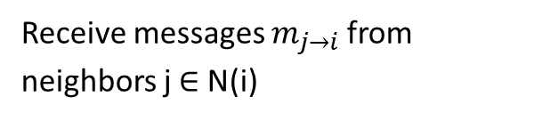



Article
Distributed Message Passing (DMP) algorithms
A DMP algorithm: each node sends messages to neighbors, aggregates what it receives, and updates its own state — repeated for T communication rounds.
This classic family unifies both optimization-based algorithms (WMMSE, Riemannian gradient, belief propagation) and GNN-based algorithms under one umbrella.
Theorem 1: for any graph optimization problem of the paper’s form, there exists a DMP algorithm that solves it — because any such solution map is provably permutation-invariant.
Algorithm 1: DMP round
1
Receive messages $m_{j→ⅈ}$from neighbors j ∈ N(i)
2
Aggregate: $y_{i}$ = $g_{1}(m_{j→ⅈ})$
3
Update state: $x_{i}$ = $g_{2}$($Z_{i},$ $x_{i}$, $y_{i}$)
Repeated for T rounds → output [${x_{i}}^{(T)}$]
Yifei Shen et al., "Graph Neural Networks for Wireless Communications: From Theory to Practice," in IEEE Transactions on Wireless Communications, May 2023.
Graph Neural Networks
28/40

Slide 29
Article
Theorem 2: GNNs can represent any DMP algorithm
WMMSE (Shi et al. 2011)
Classic optimization algorithm
Proposition 2: shown to be a DMP algorithm with ≤ 2T iterations.
Riemannian gradient (Yu et al. 2016)
Hybrid precoding solver
Proposition 1: its update rule is rewritten exactly as a DMP message-passing step.
ECGNN (learned)
GNN for D2D power control
A GNN layer is itself already a DMP step — with weights learned from data instead of hand-derived.
Corollary : since (1) every graph-optimization problem has a solving DMP algorithm (Thm 1) and (2) GNNs can represent any DMP algorithm (Thm 2) — there exists a GNN that solves any such wireless problem.
Yifei Shen et al., "Graph Neural Networks for Wireless Communications: From Theory to Practice," in IEEE Transactions on Wireless Communications, May 2023.
Graph Neural Networks
29/40

Slide 30
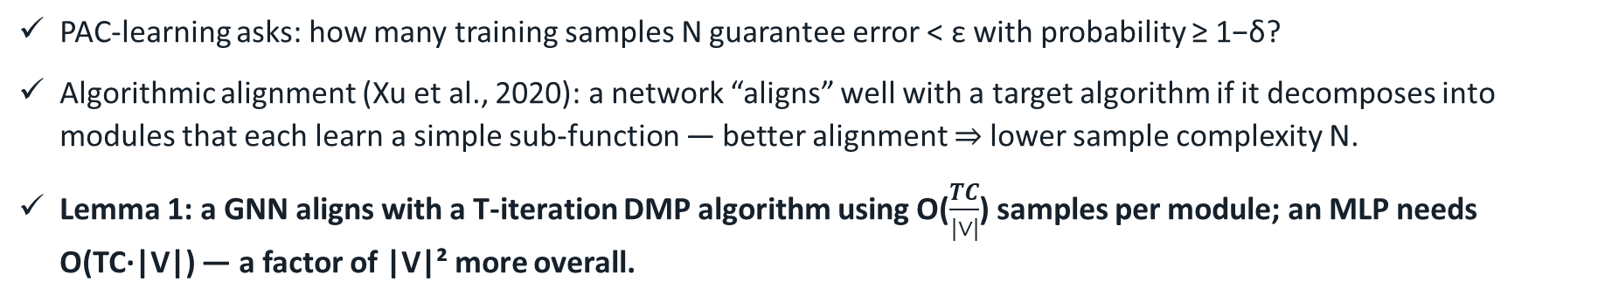
Article
Why GNNs need far fewer samples:
PAC-learning + algorithmic alignment
PAC-learning asks: how many training samples N guarantee error < ε with probability ≥ 1−δ?
Algorithmic alignment (Xu et al., 2020): a network “aligns” well with a target algorithm if it decomposes into modules that each learn a simple sub-function — better alignment ⇒ lower sample complexity N.
Lemma 1: a GNN aligns with a T-iteration DMP algorithm using O($\frac{TC}{|∨|}$) samples per module; an MLP needs O(TC·|V|) — a factor of |V|² more overall.
O(n²)
times fewer training samples than MLPs
O(n)
times lower generalization error than MLPs (Thm 4)
Yifei Shen et al., "Graph Neural Networks for Wireless Communications: From Theory to Practice," in IEEE Transactions on Wireless Communications, May 2023.
Graph Neural Networks
30/40

Slide 31
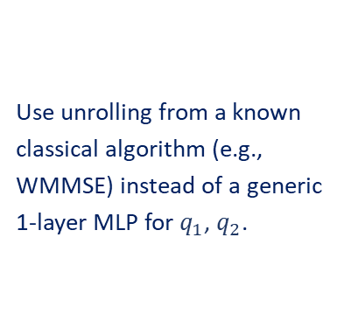
Article
Four guidelines for enhancing a base GNN
1
2
3
4
Simplify message passing
Pick a matching pooling function
Improve aggregation & combination nets
Add input embeddings
Fewer / more targeted incoming messages reduce the complexity of the function each module must learn.
Max for sparse influence (e.g., strongest interferer); sum for aggregate statistics; attention when correlations matter.
Use unrolling from a known classical algorithm (e.g., WMMSE) instead of a generic 1-layer MLP for $q_{1}$, $q_{2}$.
Lift low-dimensional edge/node features into a higher-dimensional space so the network does not ignore them.
Yifei Shen et al., "Graph Neural Networks for Wireless Communications: From Theory to Practice," in IEEE Transactions on Wireless Communications, May 2023.
Graph Neural Networks
31/40

Slide 32
Article
D2D Power Control — Sample Efficiency
Training samples needed to reach matching performance (log scale)
Headline result
For K=20 users, PCGNN trained with just 20–40 samples matches an MLP trained with 16,000–64,000 samples.
Versus #transceiver pairs (fixed 100k samples)
PCGNN and ECGNN performance stays stable as the network grows; MLP performance decays linearly. PCGNN even surpasses “Best FPlinQ” at large user counts.
Yifei Shen et al., "Graph Neural Networks for Wireless Communications: From Theory to Practice," in IEEE Transactions on Wireless Communications, May 2023.
Graph Neural Networks
32/40

Slide 33
Article
D2D Robustness to SNR & Channel Shift
Table II — Robustness to transmit-power / SNR level (K=10, normalized by Best FPlinQ)
Tx Power (dBm)
PCGNN
PCGNN (Full Training)
FPlinQ
0
96.12%
97.10%
93.43%
10
96.80%
97.20%
93.75%
20
97.00%
97.39%
93.62%
30
96.65%
97.12%
93.31%
40
96.90%
97.13%
93.18%
Table III — Robustness to channel distribution shift (K=10)
Setting
PCGNN
PCGNN (Full Training)
FPlinQ
User distribution shift
97.62%
97.78%
93.51%
Antenna height shift
97.63%
97.63%
93.66%
LoS → NLoS
94.43%
97.53%
93.51%
ITU → LTE
88.71%
96.57%
94.32%
Yifei Shen et al., "Graph Neural Networks for Wireless Communications: From Theory to Practice," in IEEE Transactions on Wireless Communications, May 2023.
Graph Neural Networks
33/40

Slide 34
Article
Cell-Free Massive MIMO Power Control
Table IV — Average minimum rate, normalized by the optimal algorithm (M = 30 APs)
K
Max Power
MLP
HetGNN
CF-PCGNN
6
46.3%
84.4%
94.9%
95.1%
8
35.8%
74.8%
91.9%
93.1%
10
29.4%
70.5%
90.8%
91.4%
CF-PCGNN also generalizes: trained on K=6 users, it keeps 90% + performance when tested on K=6–10 — and gains over MLP grow with K.
Yifei Shen et al., "Graph Neural Networks for Wireless Communications: From Theory to Practice," in IEEE Transactions on Wireless Communications, May 2023.
Graph Neural Networks
34/40

Slide 35
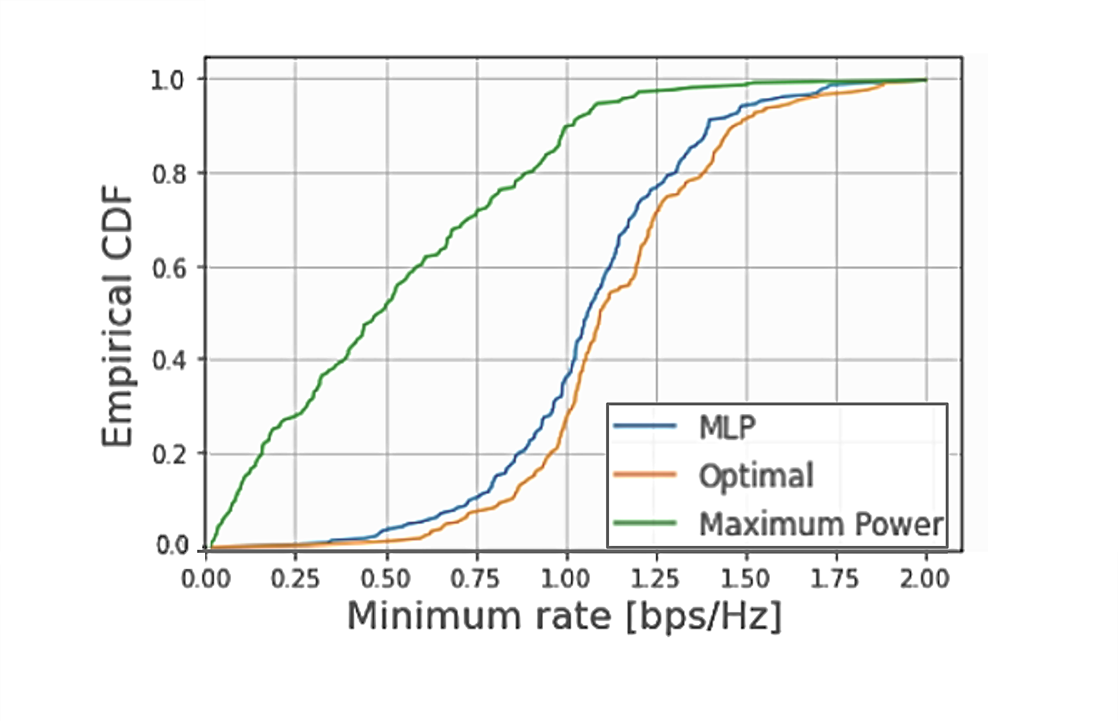
Article
Graph Neural Networks
35/40

Slide 36
Future work and Conclusion

Slide 37
Future work and Conclusion
Conclusion
Future Directions
A unified framework for applying GNNs to wireless networks: graph modeling, architecture design, and theory, together
Extend the graph-modeling & design framework to more wireless problems beyond D2D, cell-free, and hybrid precoding
First quantitative proof that GNNs need O(n) times lower error and O(n²) times fewer samples than MLPs
Combine GNNs with model-driven deep learning for tasks where reconstructing the underlying variable is easy
Extensive simulations confirm scalability, generalization, and large computational speedups over classic methods
Build a full theory of robustness to channel-distribution shift, beyond same-distribution generalization guarantees
Graph Neural Networks
37/40

Slide 38
References
[1] F. Scarselli, M. Gori, A. C. Tsoi, M. Hagenbuchner, and G. Monfardini, "The graph neural network model," IEEE Trans. Neural Netw., vol. 20, no. 1, pp. 61–80, Jan. 2009.
[2] Z. Wu, S. Pan, F. Chen, G. Long, C. Zhang, and P. S. Yu, "A comprehensive survey on graph neural networks," IEEE Trans. Neural Netw. Learn. Syst., vol. 32, no. 1, pp. 4–24, Jan. 2021.
[3] J. Zhou, G. Cui, S. Hu, Z. Zhang, C. Yang, Z. Liu, L. Wang, C. Li, and M. Sun, "Graph neural networks: A review of methods and applications," AI Open, vol. 1, pp. 57–81, 2020.
[4] J. Suárez-Varela, P. Almasan, M. Ferriol-Galmés, K. Rusek, F. Geyer, X. Cheng, X. Shi, S. Xiao, F. Scarselli, A. Cabellos-Aparicio, and P. Barlet-Ros, "Graph neural networks for communication networks: Context, use cases and opportunities," IEEE Network, vol. 37, no. 3, pp. 146–153, May/June 2023.
[5] Y. Shen, J. Zhang, S. H. Song, and K. B. Letaief, "Graph neural networks for wireless communications: From theory to practice," IEEE Trans. Wireless Commun., vol. 22, no. 5, pp. 3554–3569, May 2023.
Graph Neural Networks
38/40

Slide 39
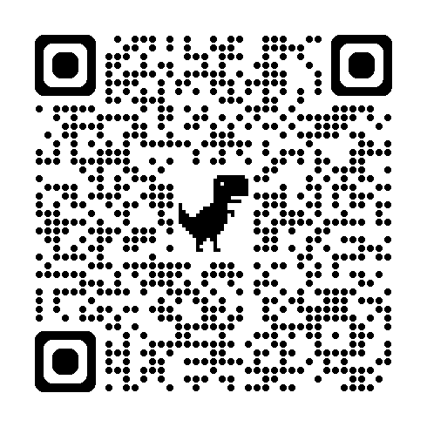
Quiz
https://forms.gle/hB2WokMPTqsVXi1L9
Graph Neural Networks
39/40

Slide 40
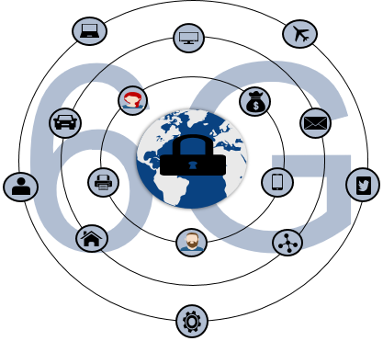
Thank you for your attention

